Slide 1

Neuromorphic engineering: computational neuroscience module
Mazzoni@Bionics 2025-2026

Slide 2
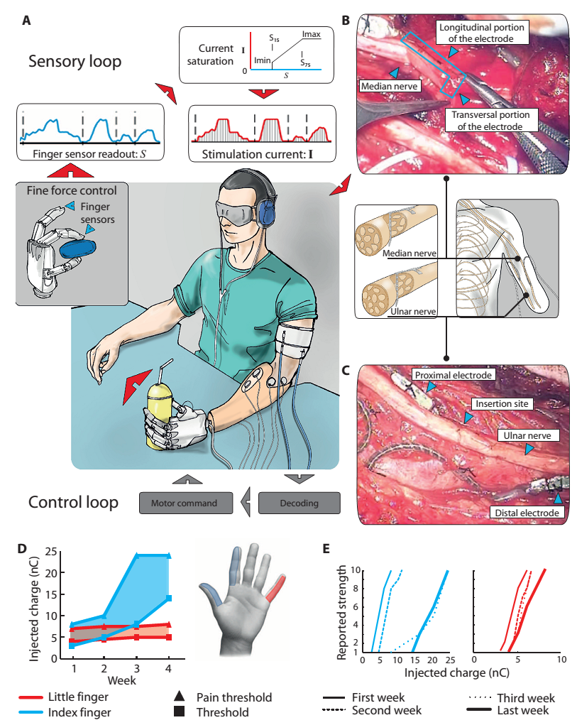
Restoring touch: hardware
Raspopovic et al. 2014 – Science Translational Medicine
The right algorithm
PRENSILIA
hand
Transverse Intrafascicular Multichannel Electrodes
Surgery (and tasks) performed @ Policnico Gemelli

Slide 3
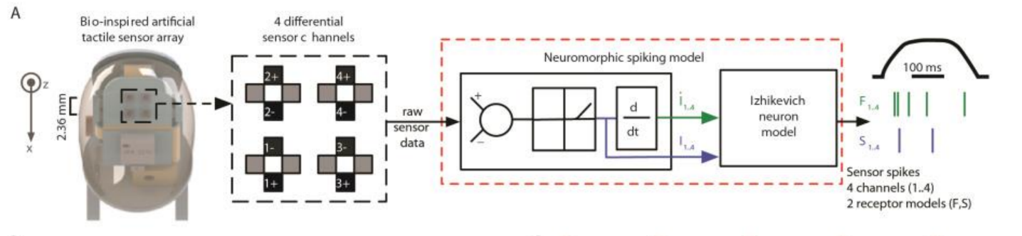
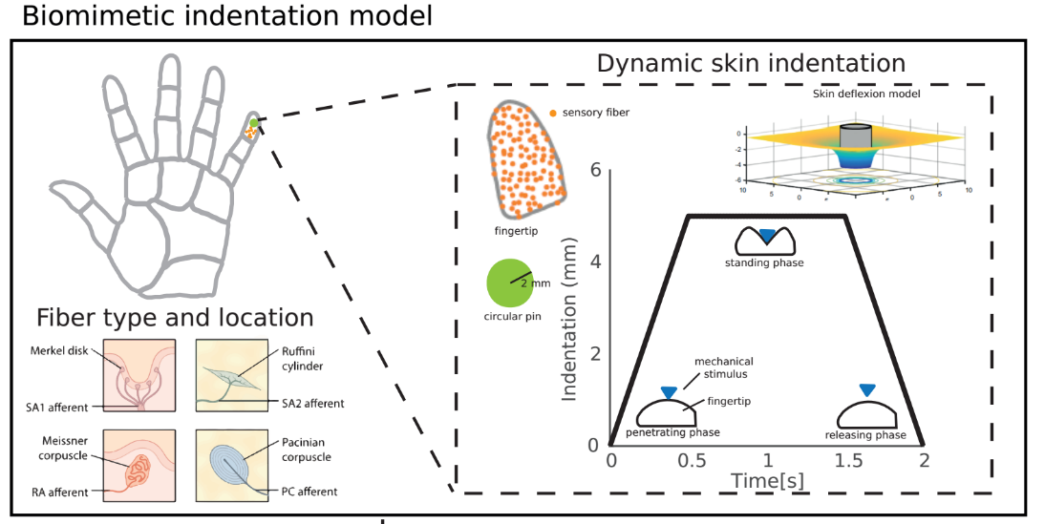
Restoring touch: algorithms
Raspopovic et al. 2014 – Science Translational Medicine
The patient is able to discriminate force levels, object shape, and modulate the grasp accordingly.
Oddo et al. 2016 – eLife
The patient is able to discriminate coarseness
Valle et al. 2018 – Scientific reports
Valle et al. 2018 – NEURON
The patient feels natural sensations and embodiment is improved

Slide 4
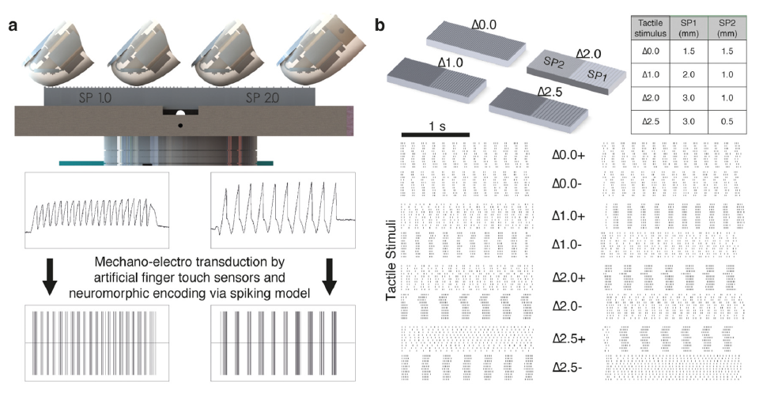
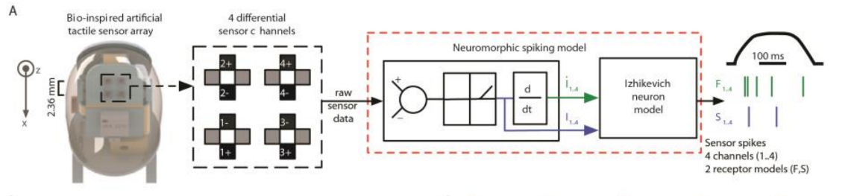
Restoring touch: texture coarseness discrimination
Oddo et al. 2016 – eLife

Slide 5
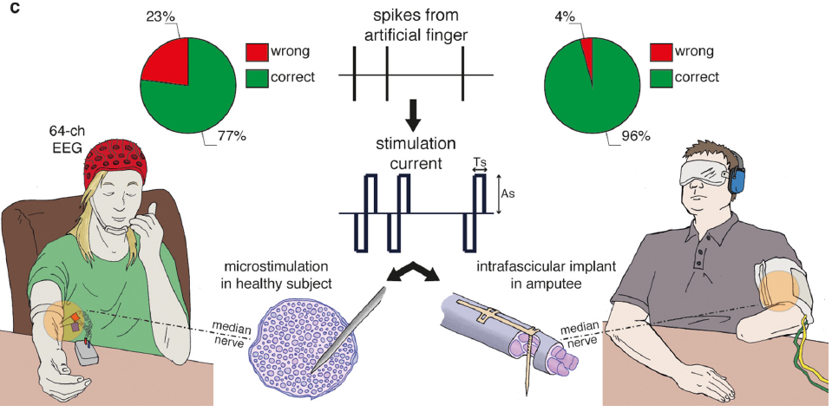
Restoring touch: texture coarseness discrimination
Oddo et al. 2016 – eLife

Slide 6
Can we really compare these two approaches? We need a model!
Oddo et al. 2016 – eLife

Slide 7
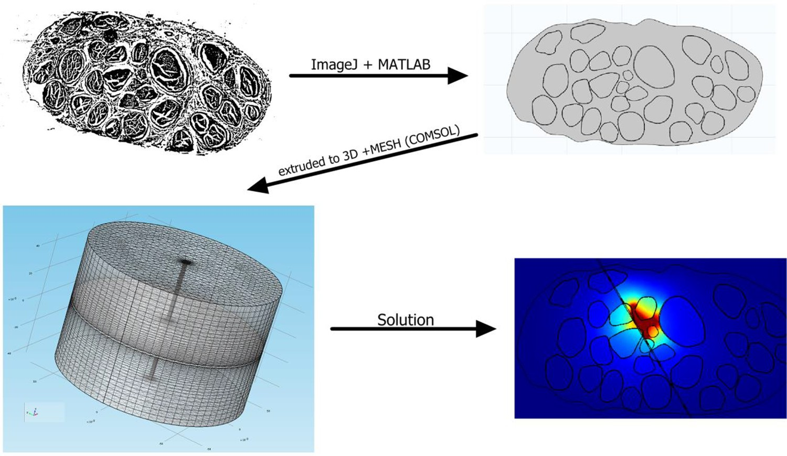
Microneedle vs TIME: the model
Oddo et al. 2016 – eLife

Slide 8
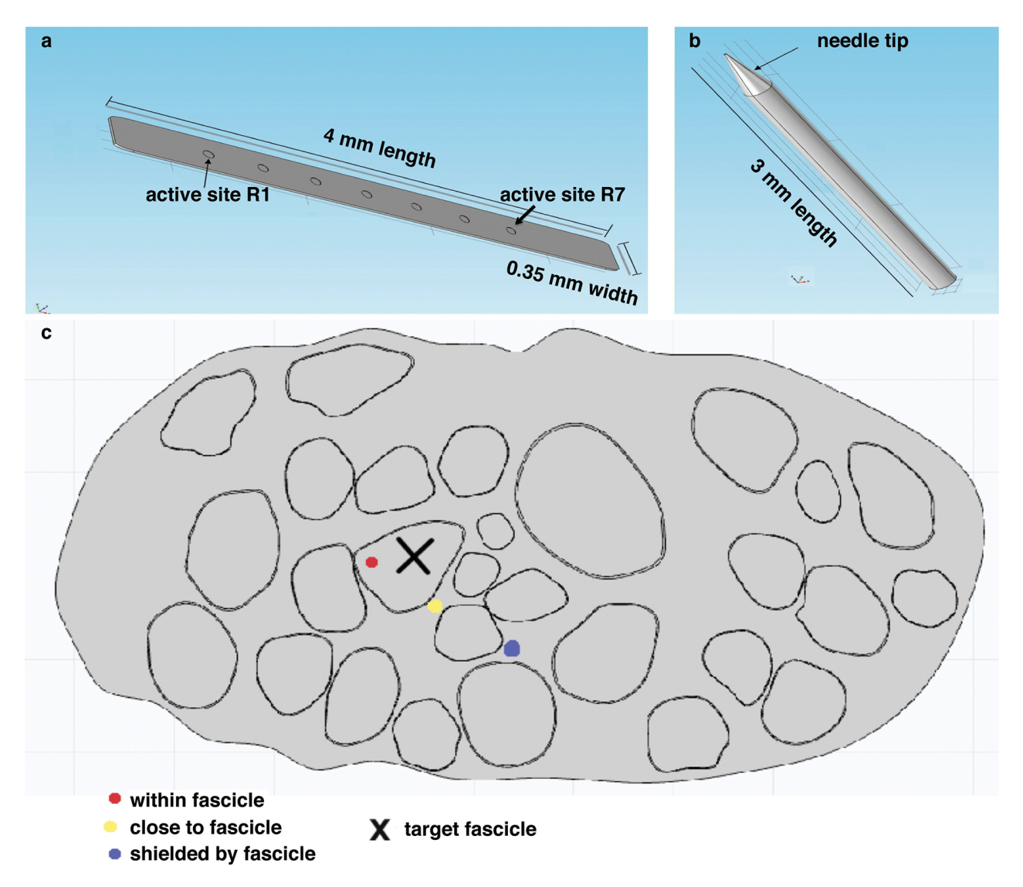
Microneedle vs TIME: the model
Oddo et al. 2016 – eLife

Slide 9
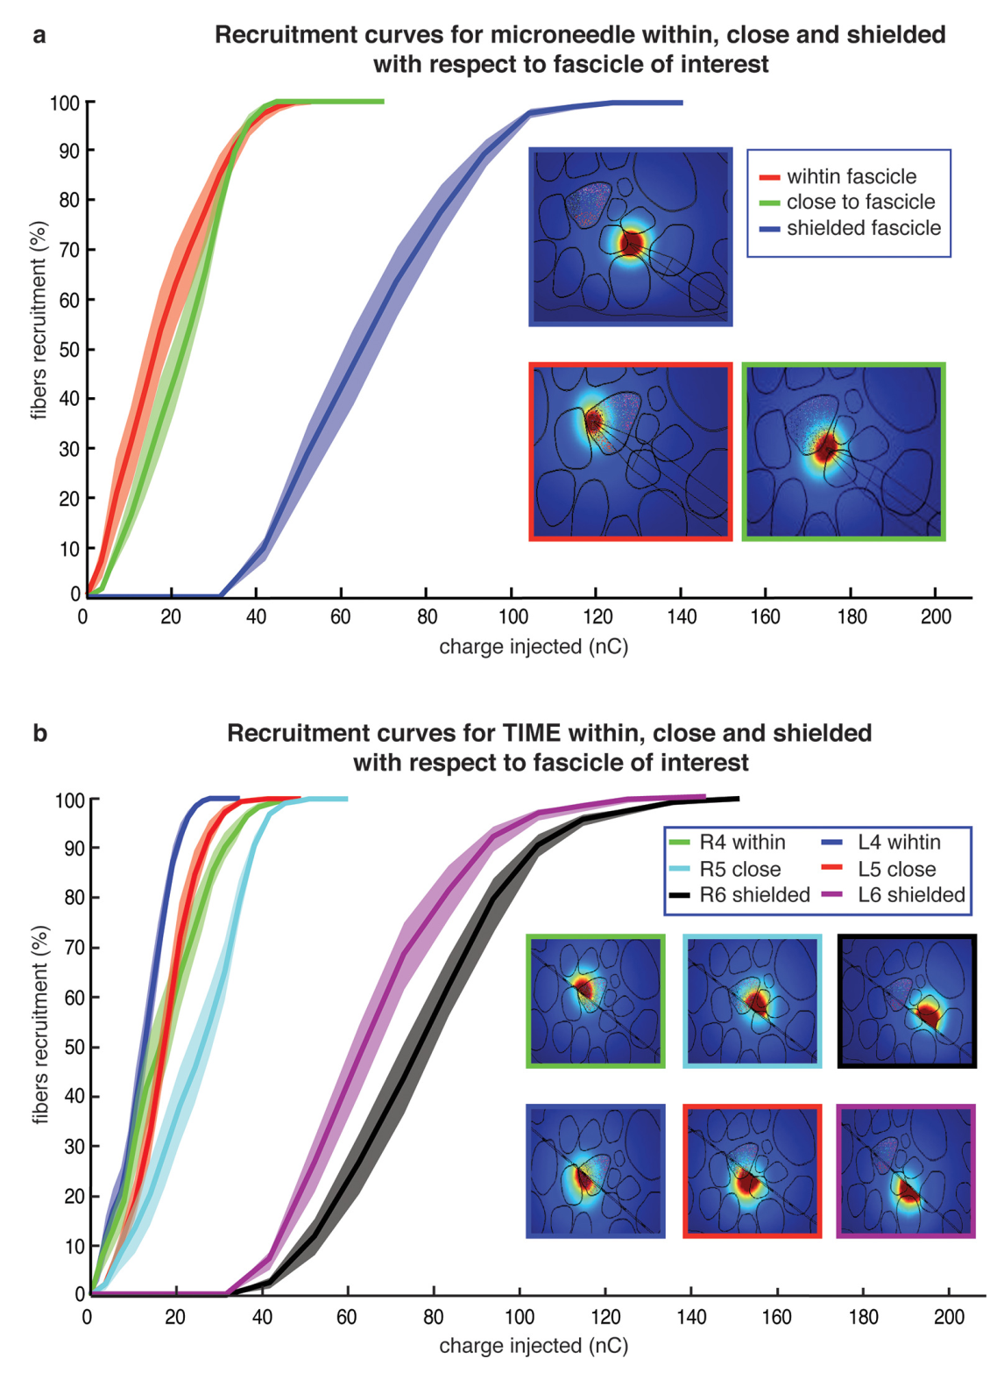
Microneedle
vs TIME:
the model
Getting to the right spot is easier with TIME, but once you get there the performance of a single contact with microneedle is just as good
Oddo et al. 2016 – eLife

Slide 10
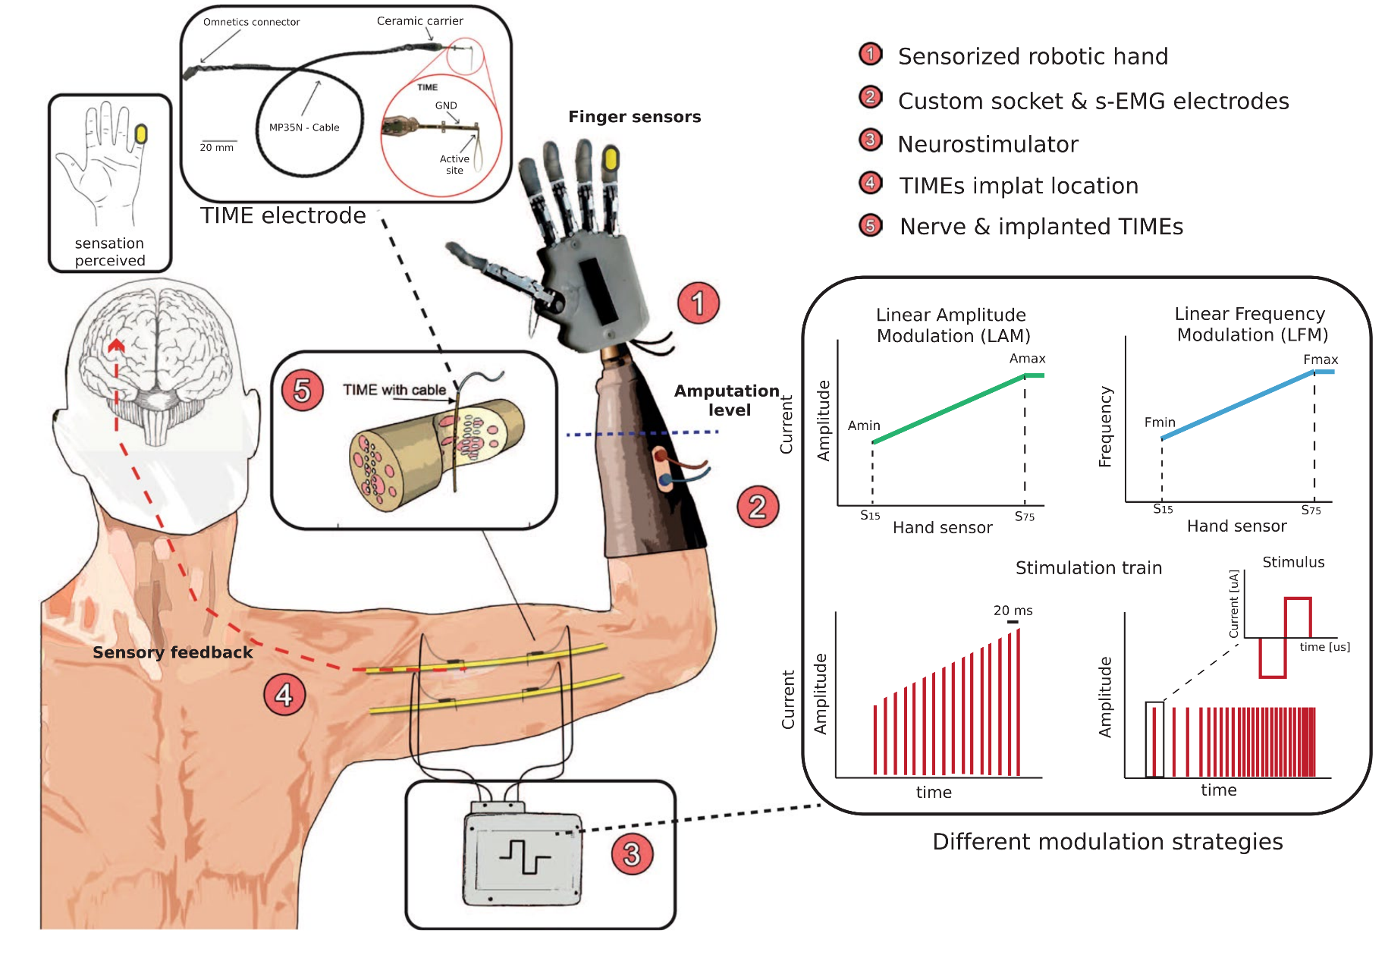
Back to basics
Valle et al. 2018 – Scientific Reports

Slide 11
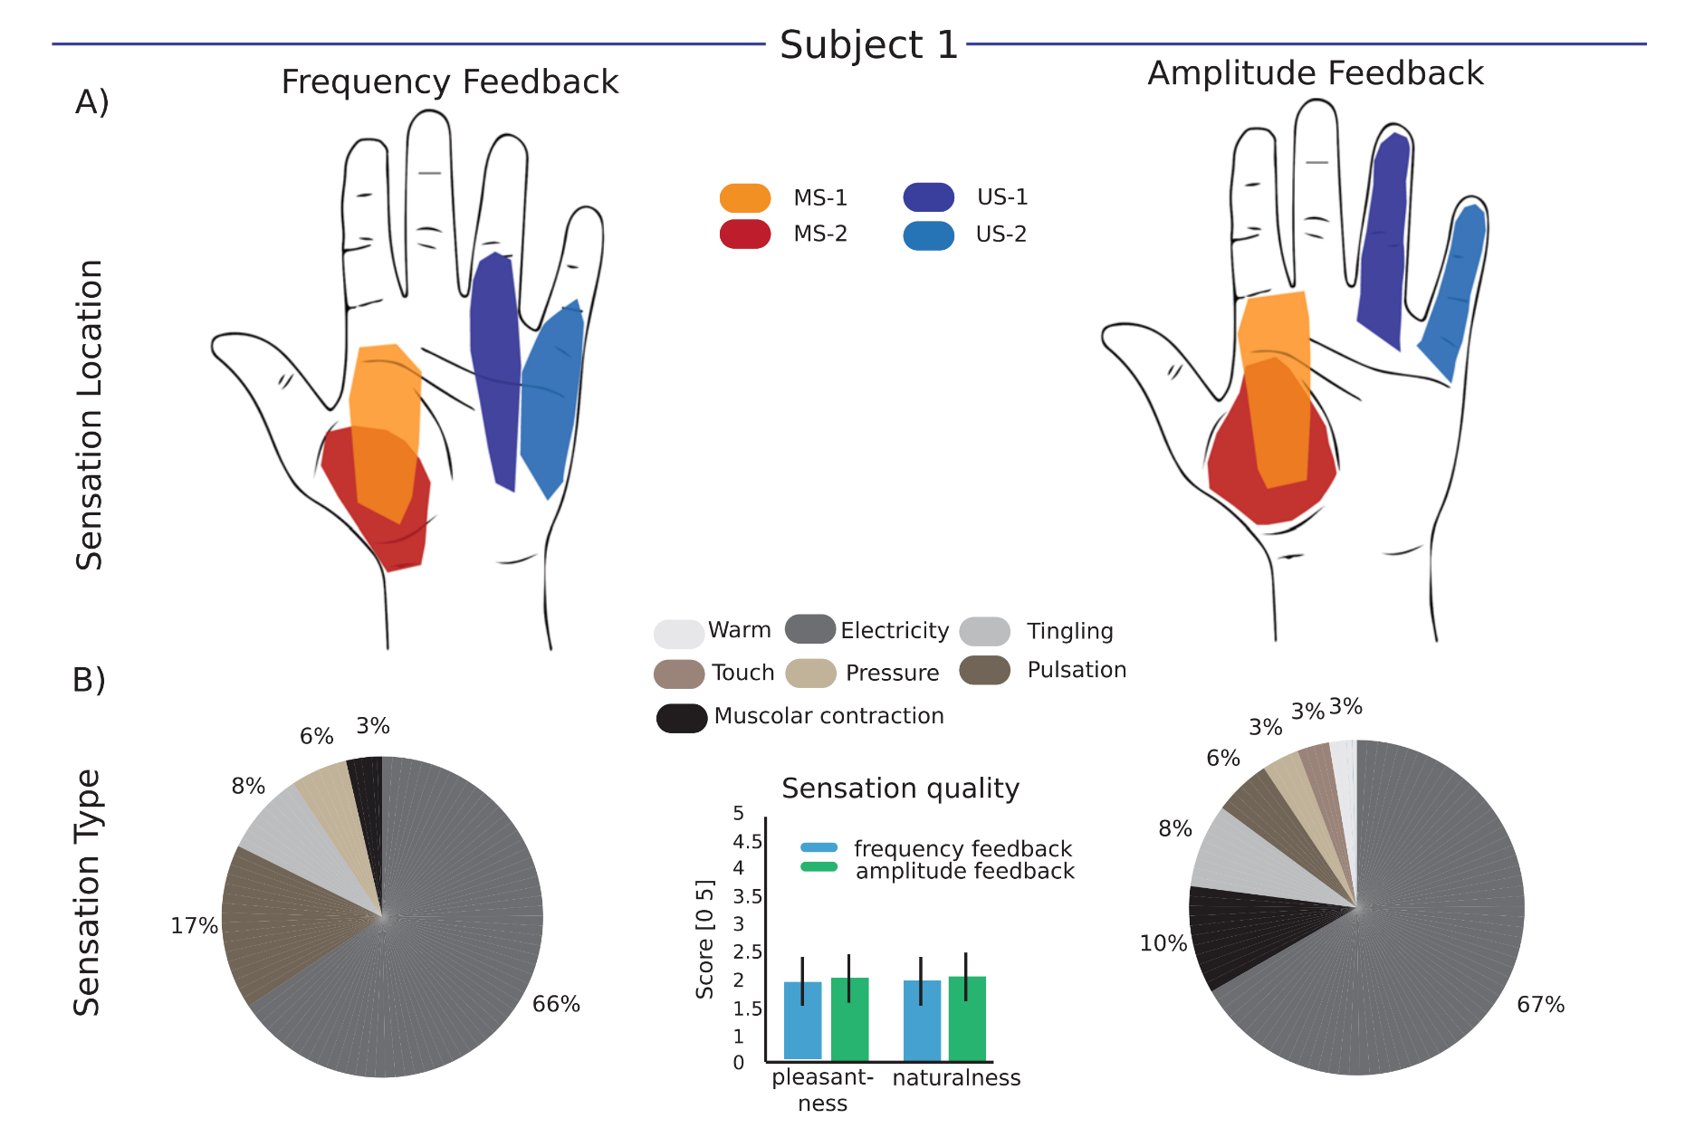
Frequency vs amplitude
Valle et al. 2018 – Scientific Reports

Slide 12
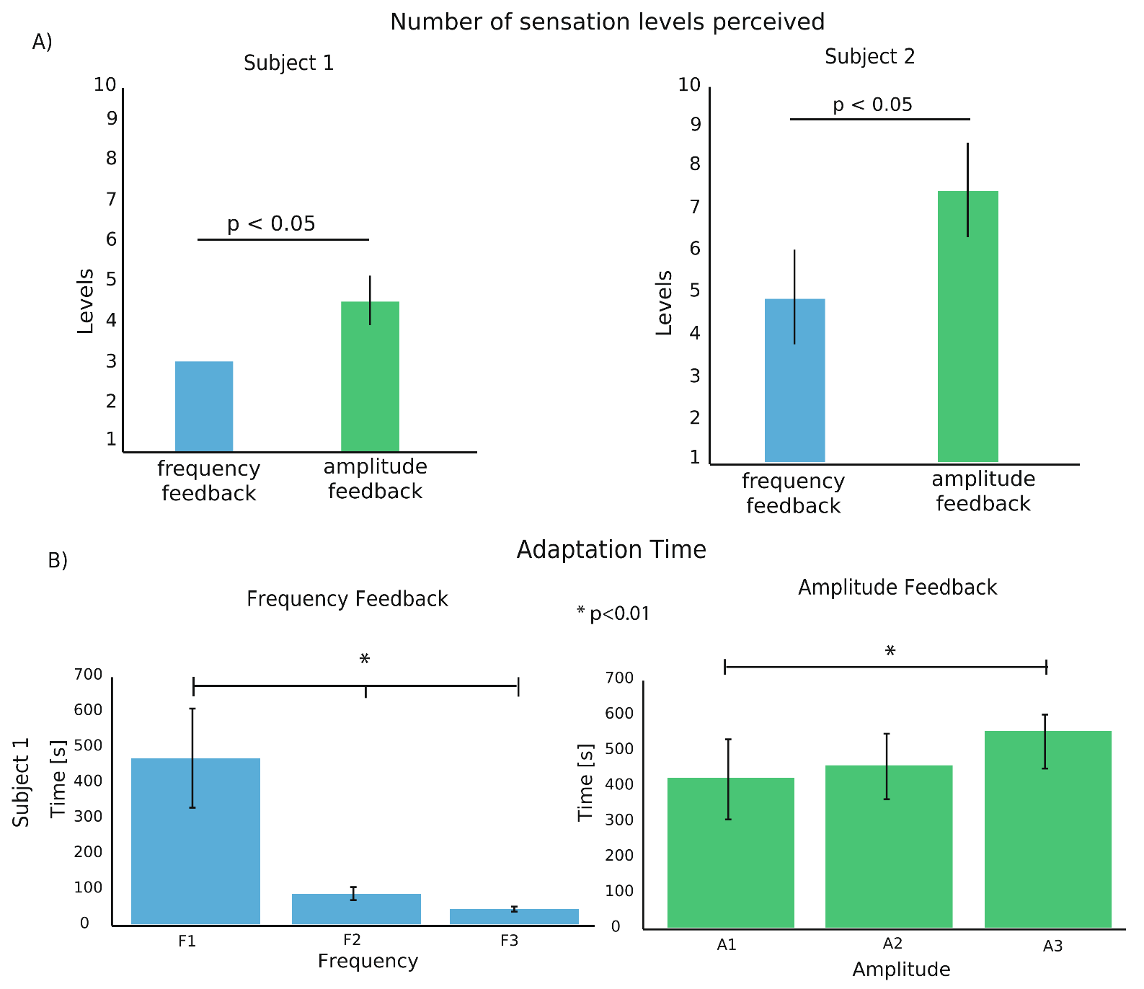
Frequency vs amplitude
Valle et al. 2018 – Scientific Reports

Slide 13
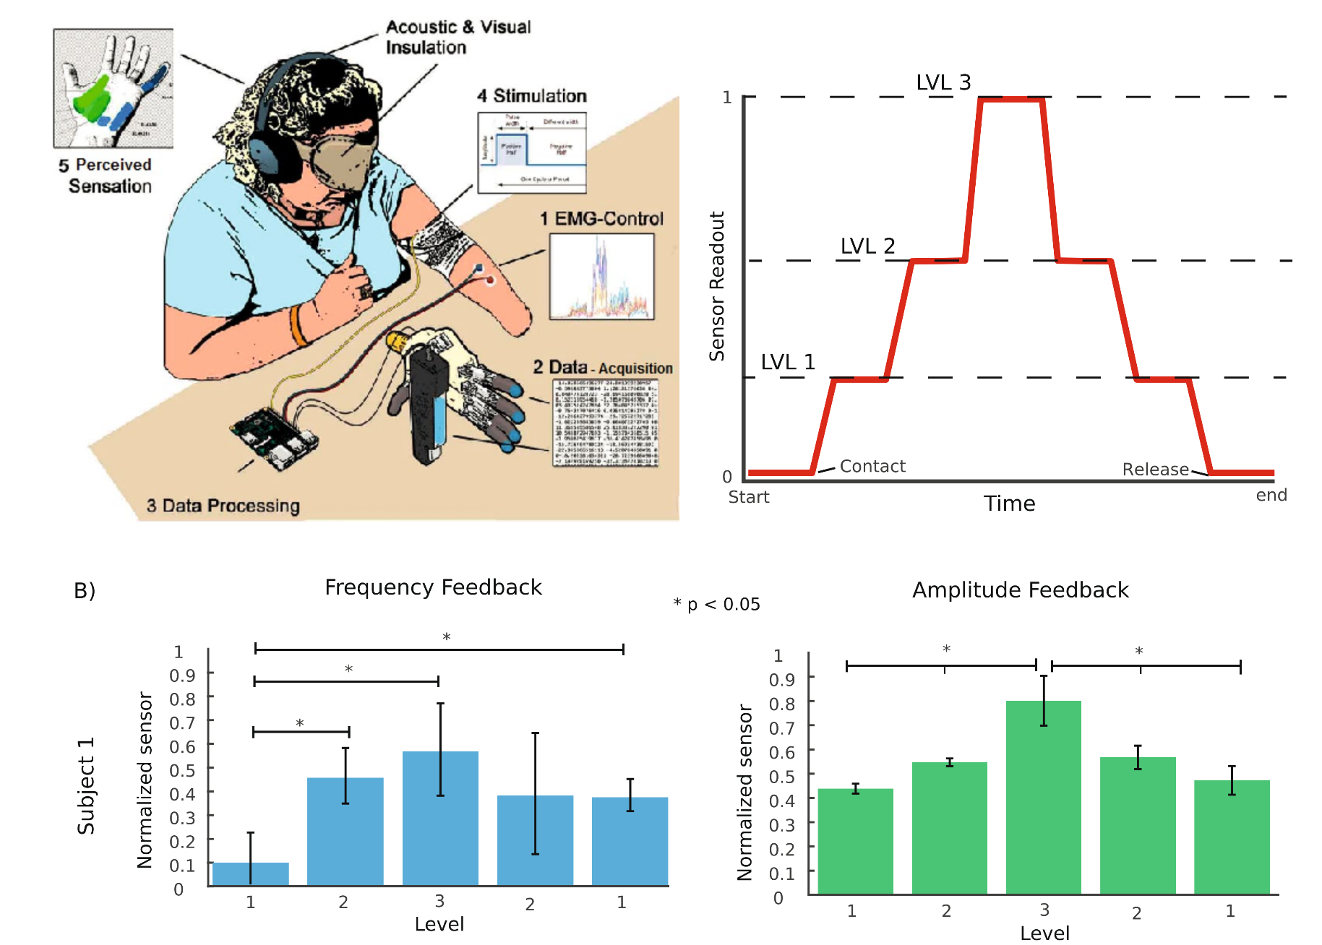
Frequency vs amplitude
Valle et al. 2018 – Scientific Reports

Slide 14
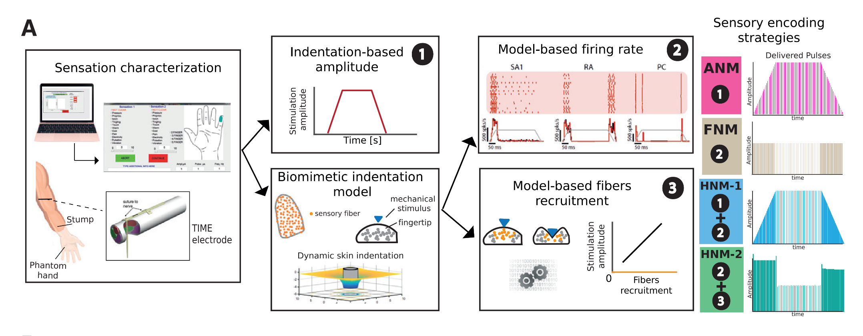
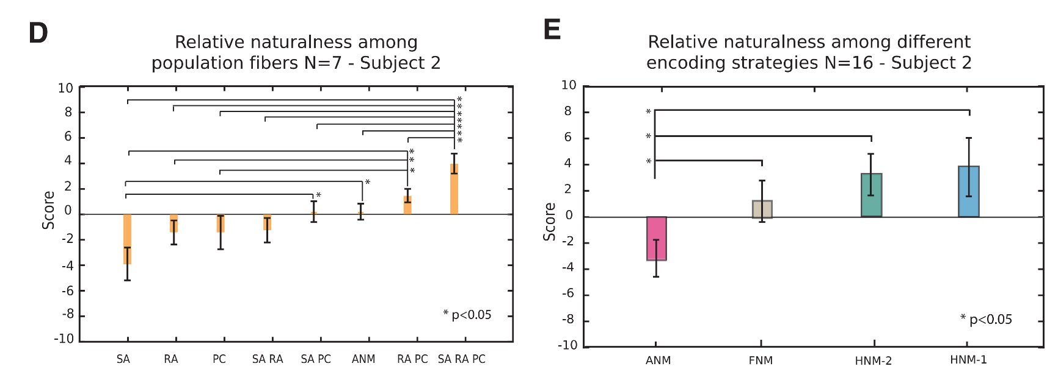
Model battle
Valle et al. 2018 – Neuron

Slide 15
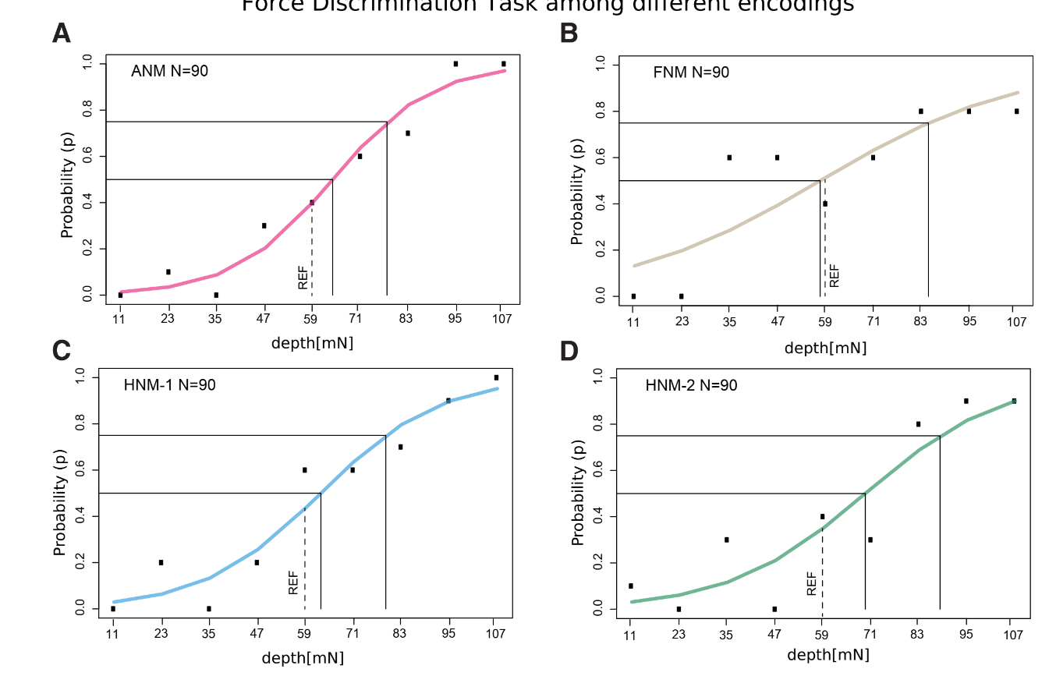
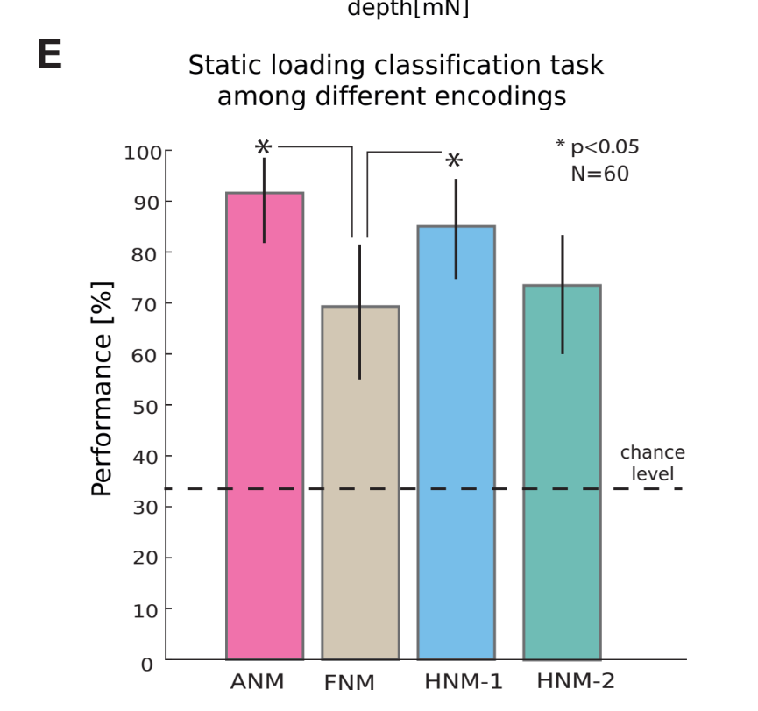
Model battle
Valle et al. 2018 – Neuron

Slide 16
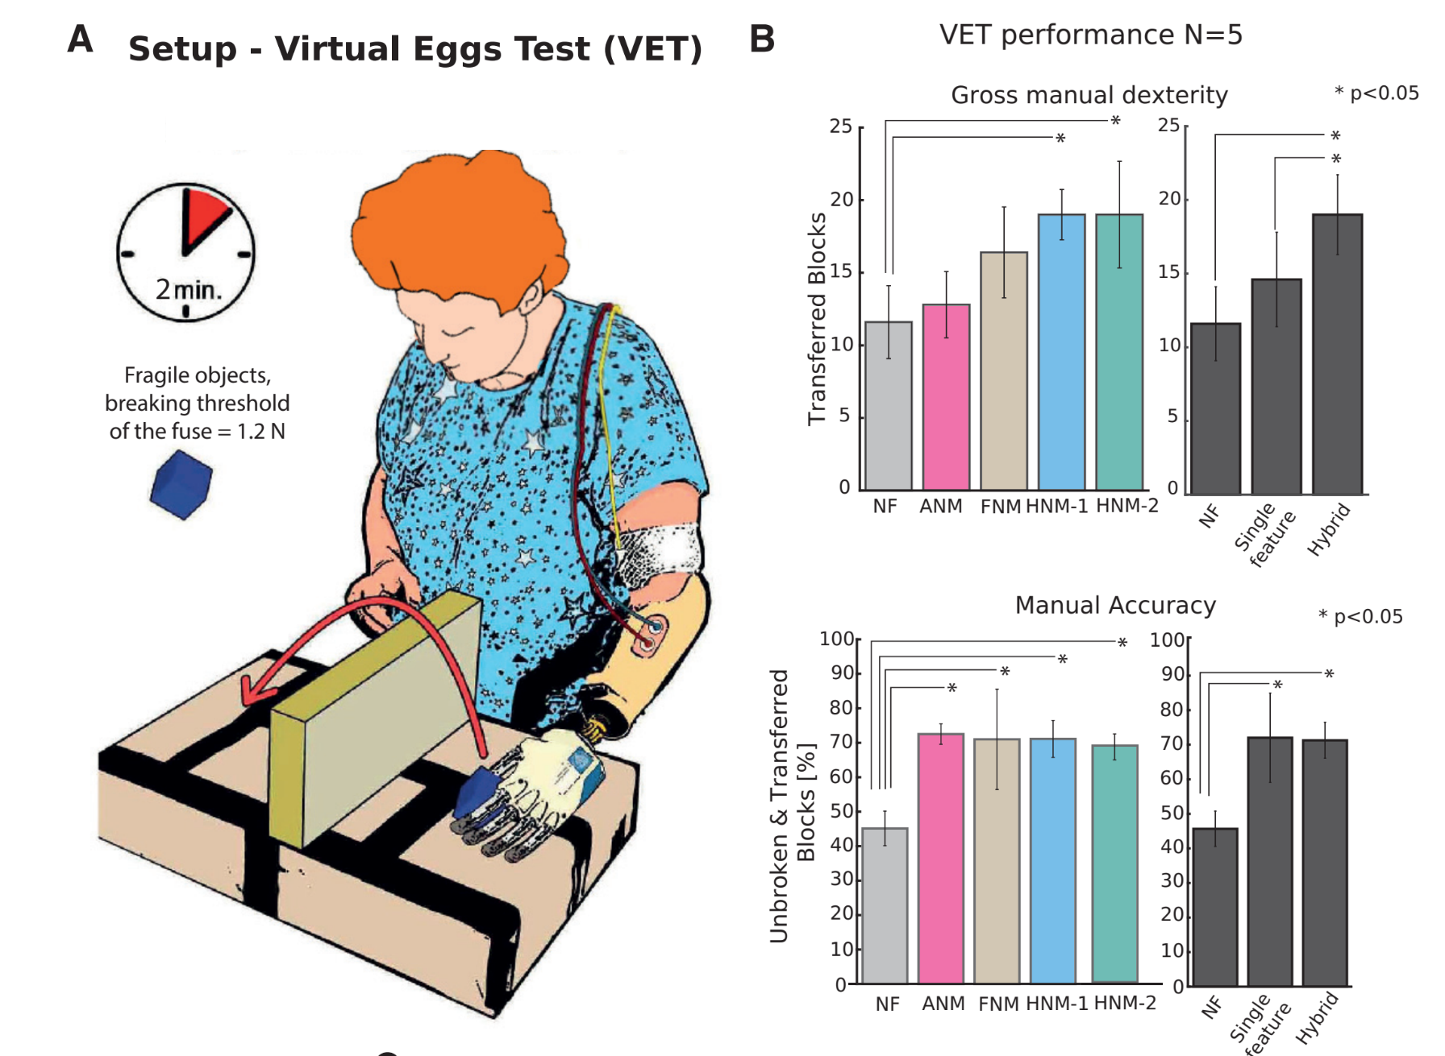
Model battle
Valle et al. 2018 – Neuron

Slide 17
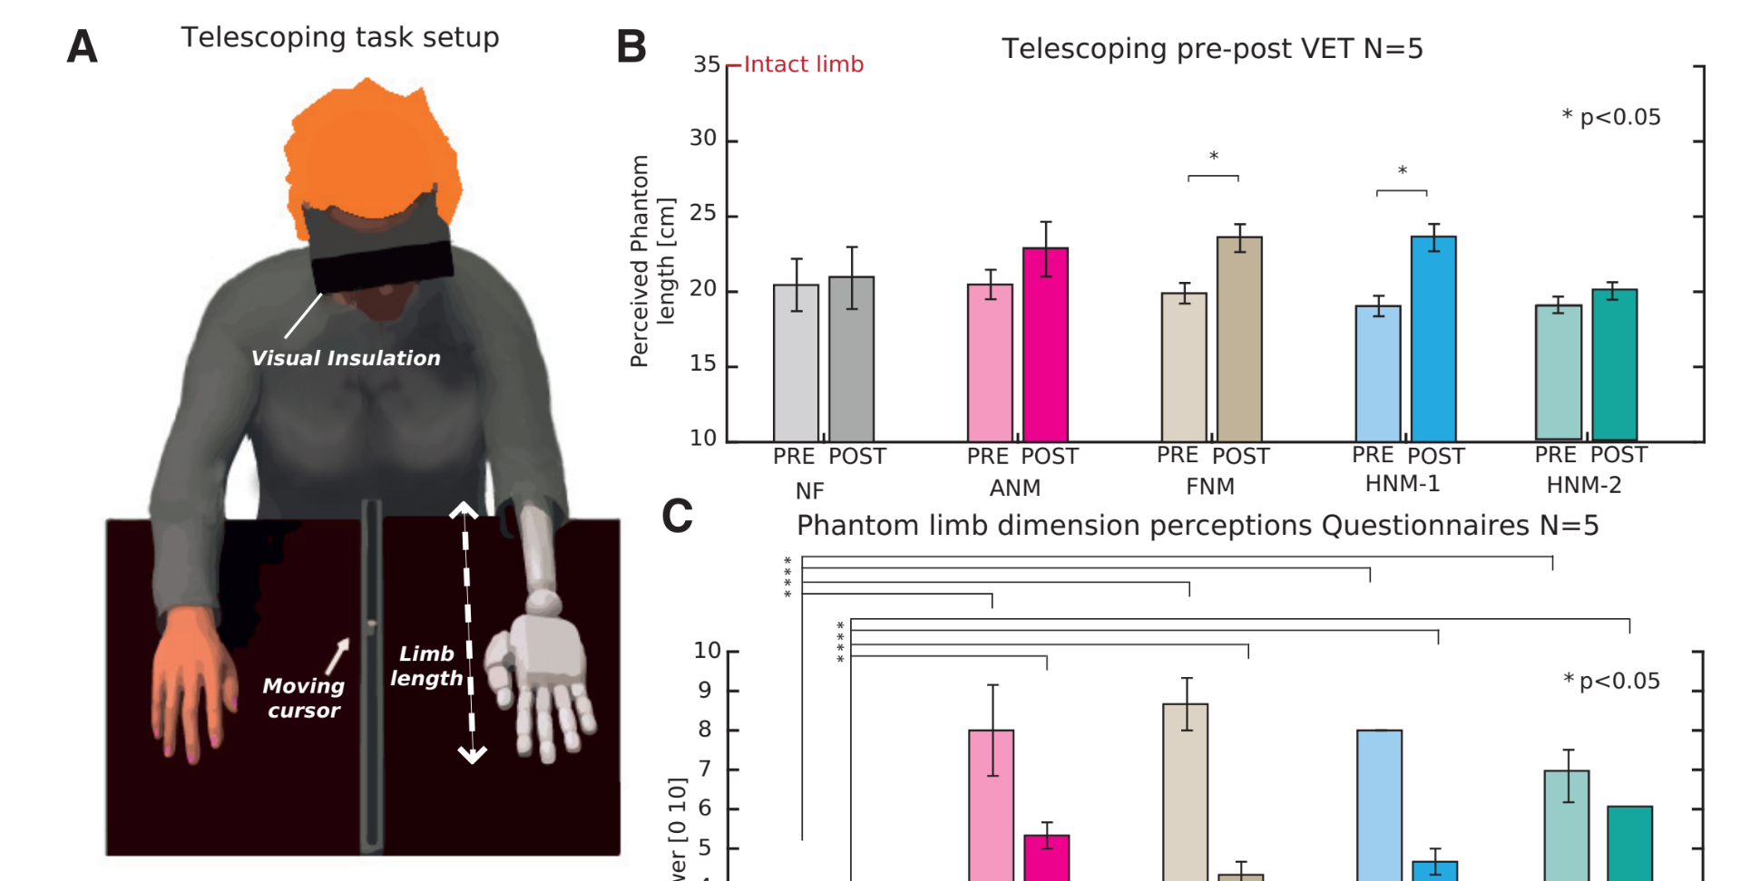
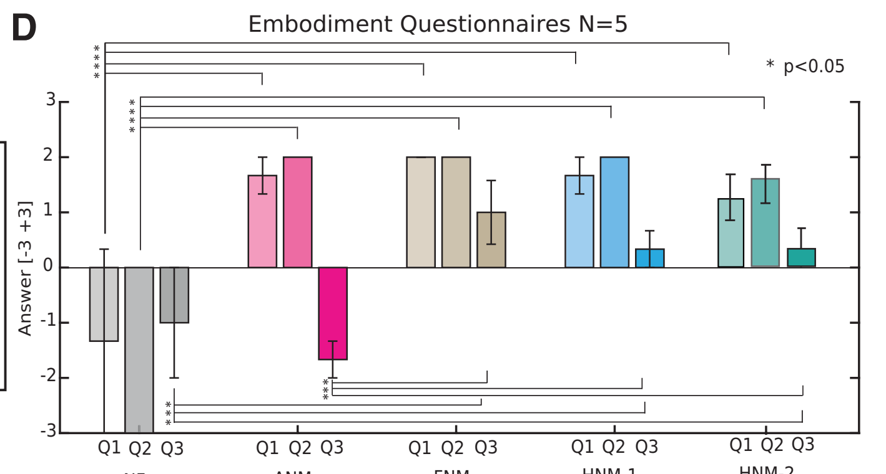
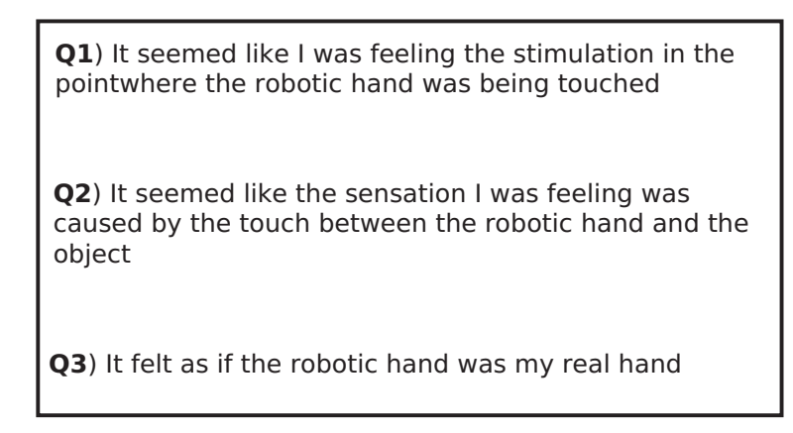
Model battle
Valle et al. 2018 – Neuron

Slide 18
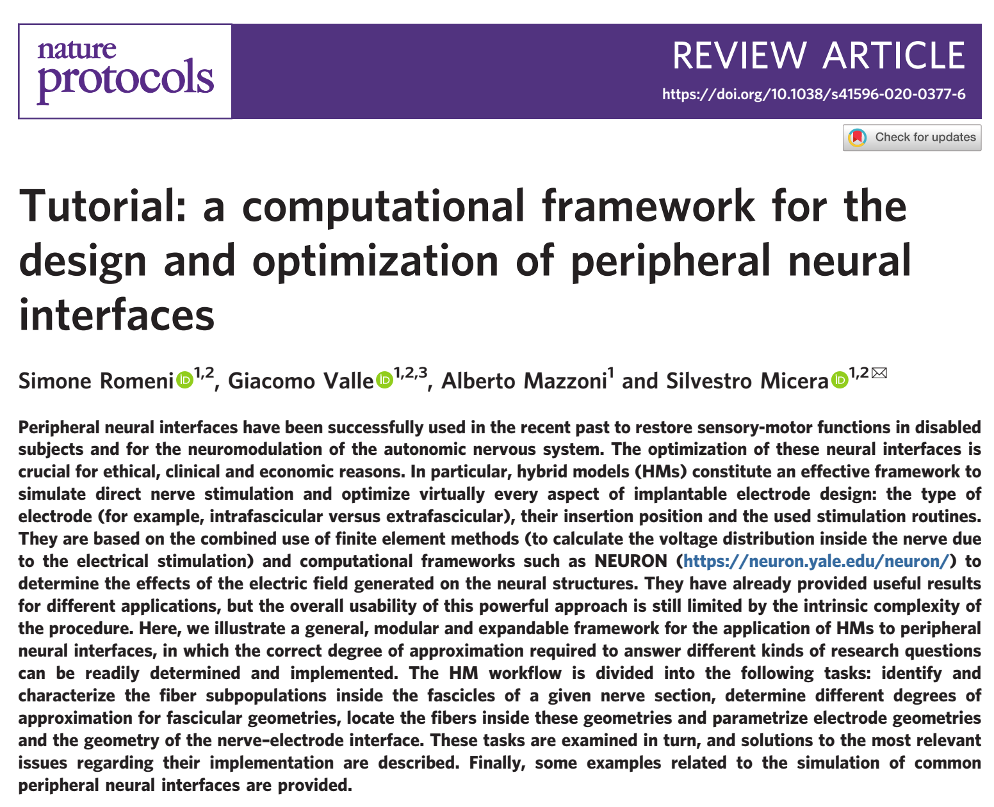
Interface model step by step
Romeni et al 2020 - Nature Protocols

Slide 19
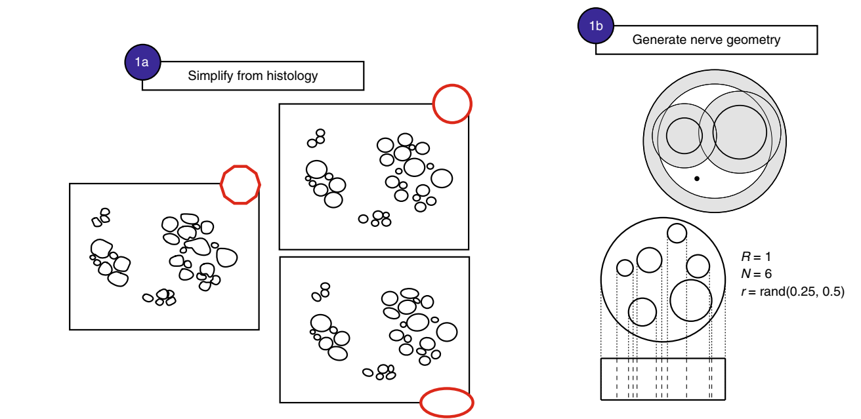
Neural geometry
Romeni et al 2020 - Nature Protocols

Slide 20
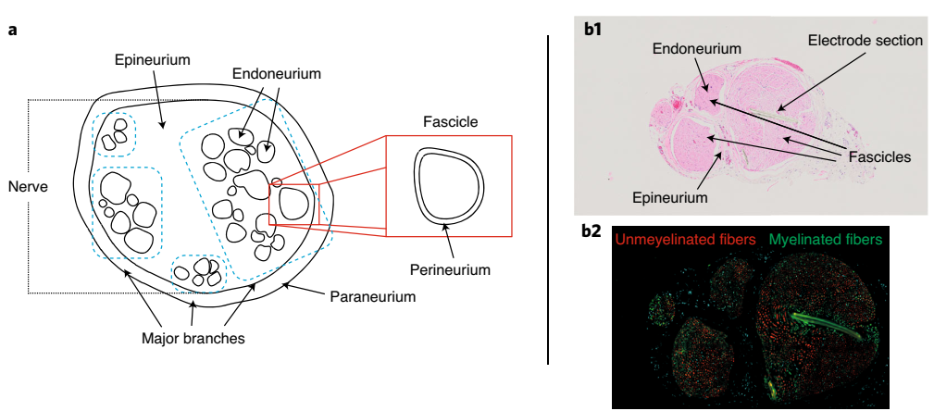
Histology
Romeni et al 2020 - Nature Protocols

Slide 21
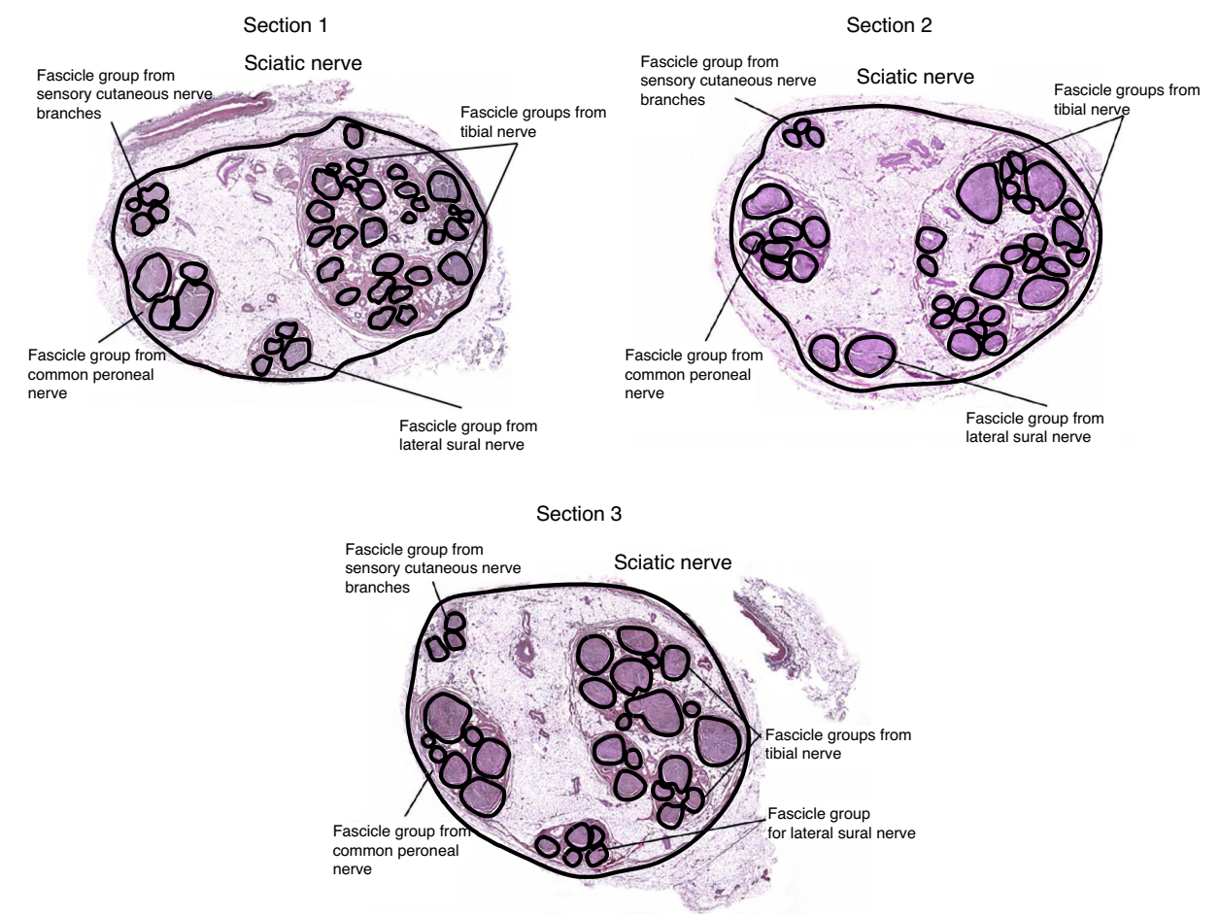
Segmentation
Romeni et al 2020 - Nature Protocols

Slide 22
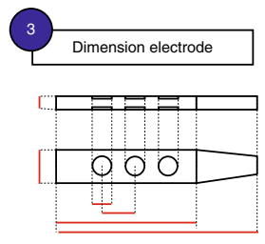
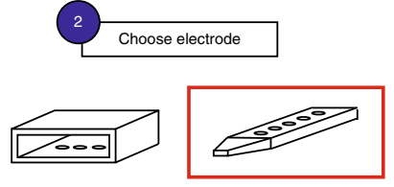
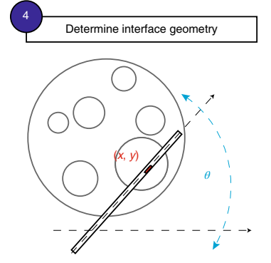
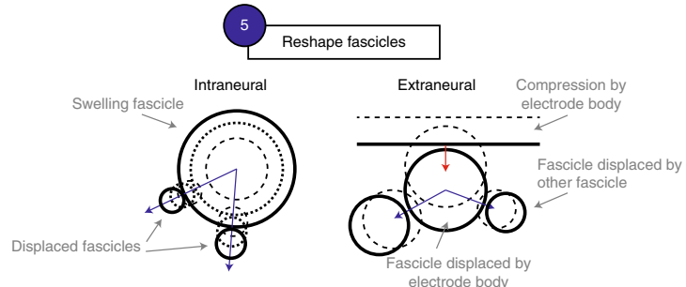
Interface geometry
Romeni et al 2020 - Nature Protocols

Slide 23
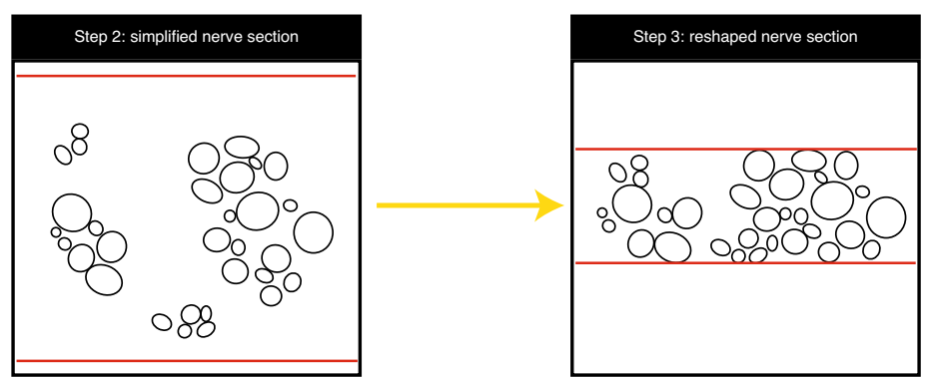
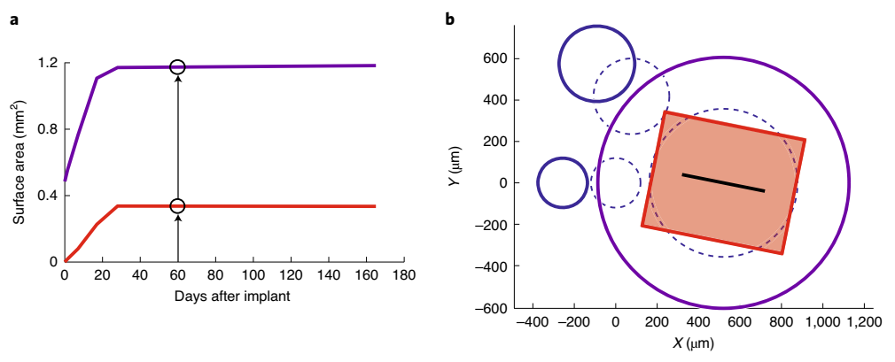
Reshaping
Romeni et al 2020 - Nature Protocols

Slide 24
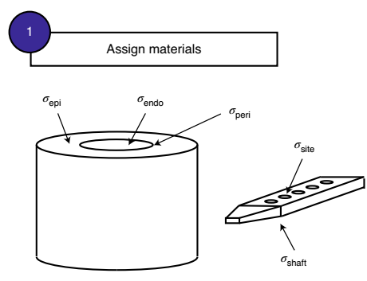
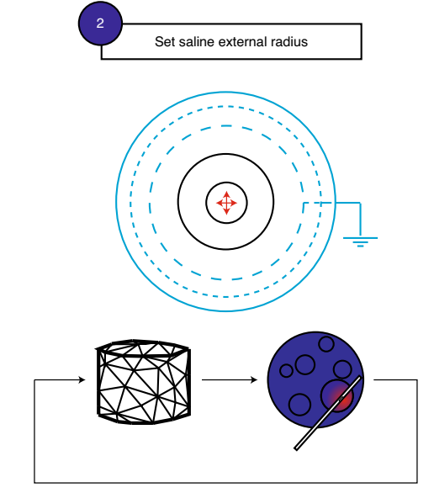
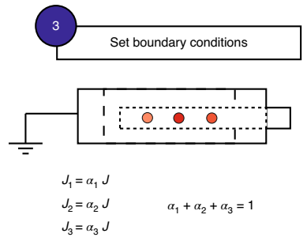
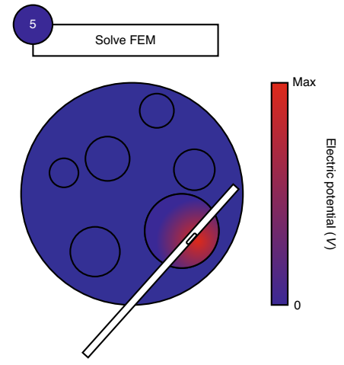
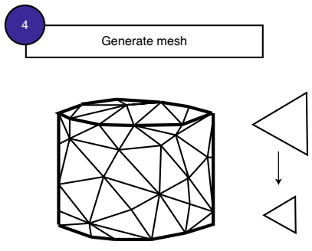
Volume of Tissue Activated
Romeni et al 2020 - Nature Protocols

Slide 25
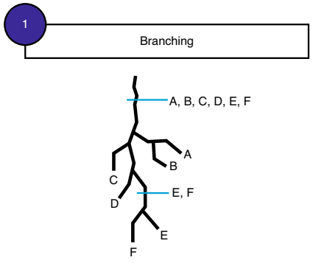
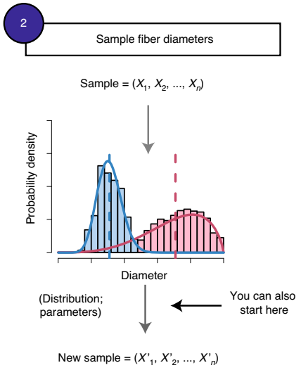
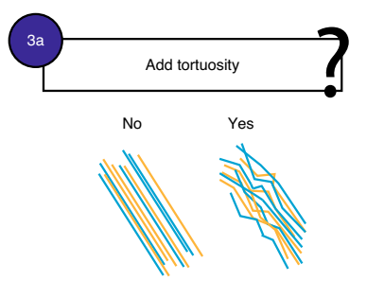
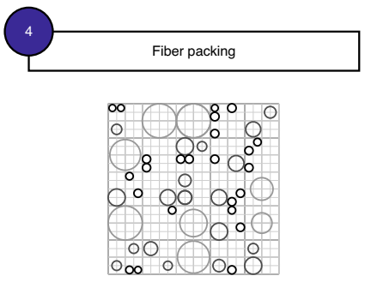
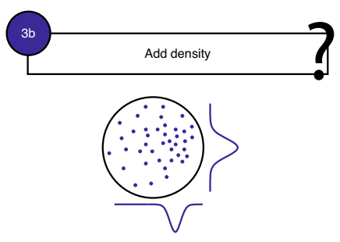
Fibers
Romeni et al 2020 - Nature Protocols

Slide 26
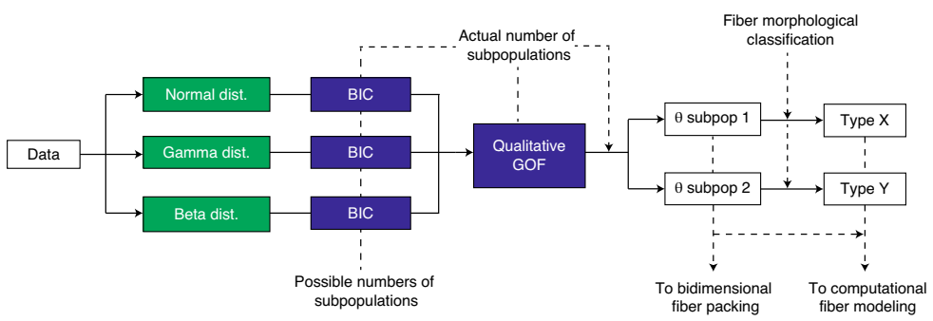
Fibers diameter
Romeni et al 2020 - Nature Protocols

Slide 27
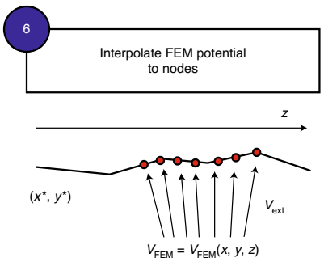
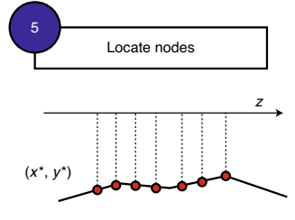
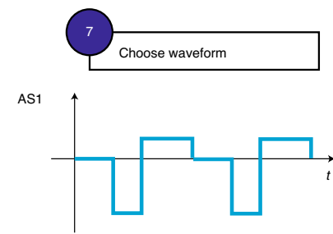
Cable equations
Romeni et al 2020 - Nature Protocols

Slide 28
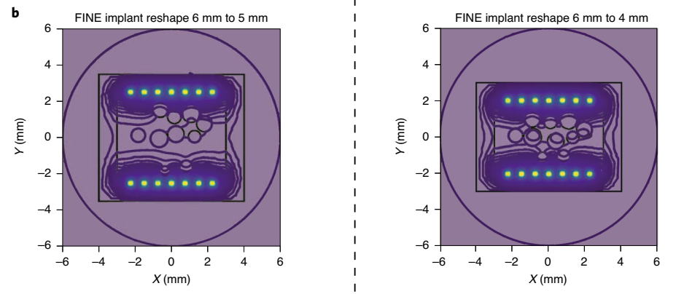
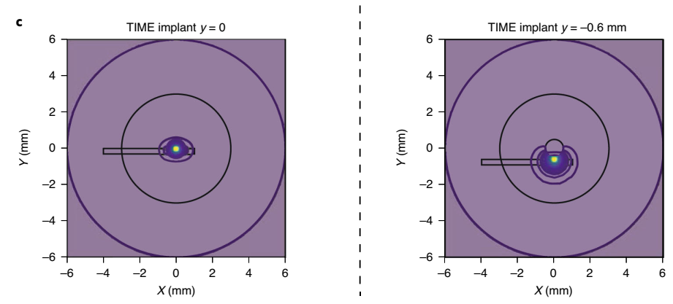
Stimulation estimates
Romeni et al 2020 - Nature Protocols

Slide 29
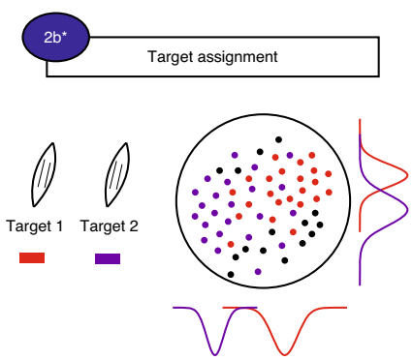
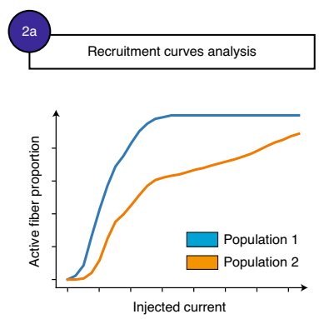
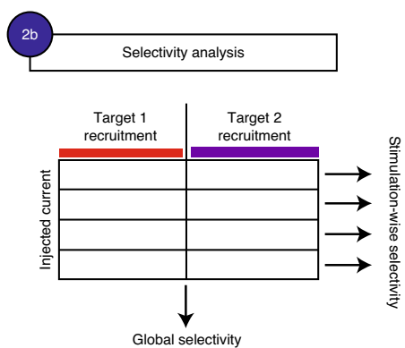
Global results
Romeni et al 2020 - Nature Protocols

Slide 30



Slide 31


Slide 33


